Slide 1

7th Grade Math
Unit 9, Lesson 6 Rewriting Equivalent Numerical Expressions Volume 2, pg. 65

Slide 2


Benchmark
MA.7.AR.1.2
Determine whether two linear expressions are equivalent.
volume 2, pg. 65

Slide 3
Integrated Mathematical Thinking and Reasoning Standards
MA.K12.MTR.3.1 Complete tasks with mathematical fluency.
MA.K12.MTR.4.1 Engage in discussions that reflect on the mathematical thinking of self and others.
volume 2, pg. 65

Slide 4

Learning Target
I can determine if two numerical expressions are equivalent by rewriting each in the same form.
volume 2, pg. 65

Slide 5

Warm-Up
volume 2, pg. 66

Slide 6
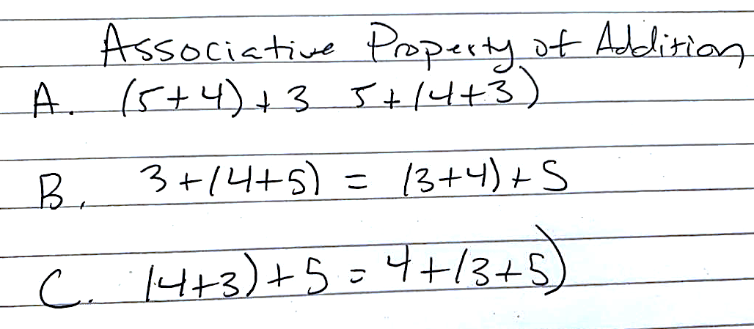
9.6.1 Warm-Up: Two Truths and a Lie
Students were asked to write two truths and a lie, or two true statements and one false statement, about the associative property of addition. One student’s work is shown.
Which statement is the lie? Justify your response.
volume 2, pg. 66

Slide 7

Guided Instruction
volume 2, pg. 66

Slide 8
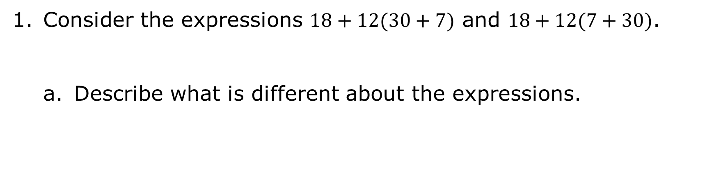
9.6.2 Guided Instruction: Rewriting Equivalent Expressions
Consider the expressions $18+12(30+7)$ and $18+12(7+30)$.
Describe what is different about the expressions.
volume 2, pg. 66

Slide 9
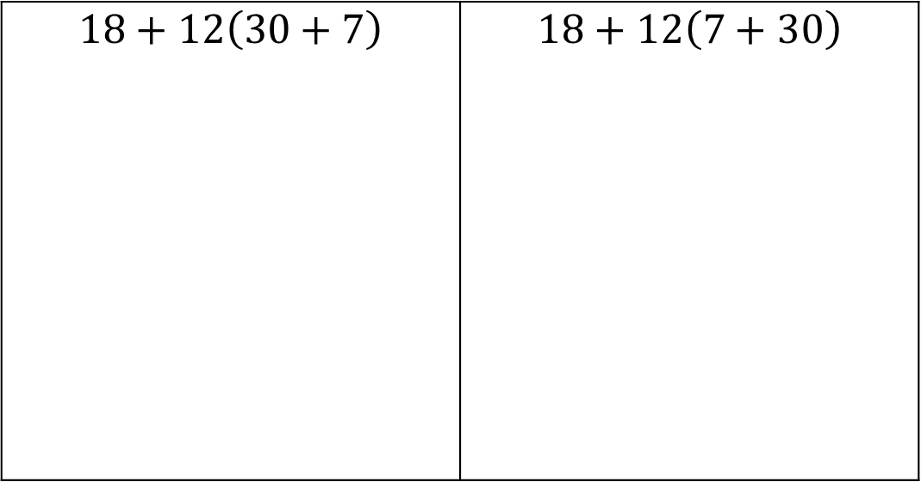
Evaluate $18+12(30+7)$ and $18+12(7+30)$.
$$18+12\left(30+7\right)$$ | $$18+12\left(7+30\right)$$
volume 2, pg. 66

Slide 10
Are the two expressions equivalent?
Was it necessary to evaluate the two expressions to determine whether they were equivalent or not?
volume 2, pg. 66

Slide 11
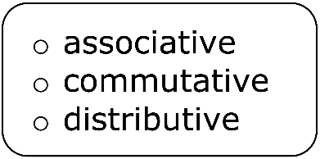
The property of addition states that the order in which two numbers are added does not matter.
For what other mathematical operations does this property hold true?
volume 2, pg. 67

Slide 12
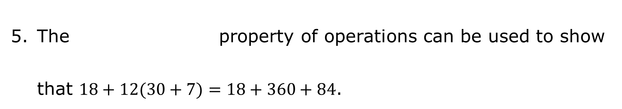
Eric thinks the expressions shown are equivalent to each other.
$$18+12\left(30+7\right)$$ | $$18+360+84$$ | $$30\left(30+7\right)$$
Without evaluating each expression, explain if he is correct.
The property of operations can be used to show that $18+12(30+7)=18+360+84$.
volume 2, pg. 67

Slide 13

Equivalent expressions can be rewritten in different forms using the properties of operations.
The following properties of operations apply to all rational numbers.
The distributive property of multiplication over addition or subtraction states that a factor is “distributed” to all terms within a set of parentheses.
The commutative property states that for addition and multiplication, the order in which the operation is performed does not change the value of the expression.
The associative property states that for addition and multiplication, the way in which numbers are grouped does not change the value of the expression.
volume 2, pg. 67

Slide 14
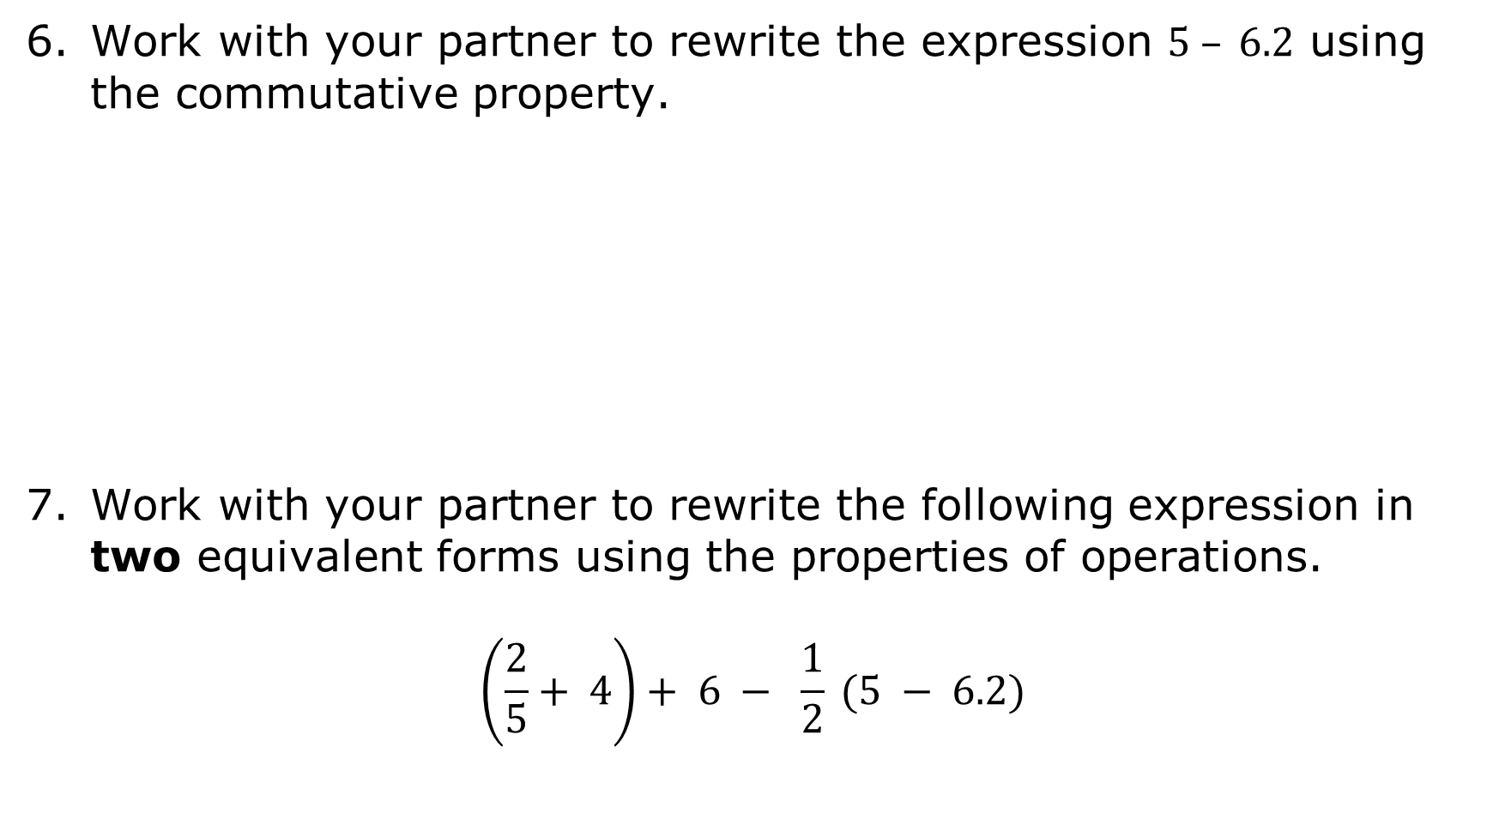
Work with your partner to rewrite the expression $5 – 6.2$ using the commutative property.
Work with your partner to rewrite the following expression in two equivalent forms using the properties of operations.
$$\left(\frac{2}{5}+ 4\right)+ 6 − \frac{1}{2} (5 − 6.2)$$
volume 2, pg. 68

Slide 15

Try It
volume 2, pg. 68

Slide 16
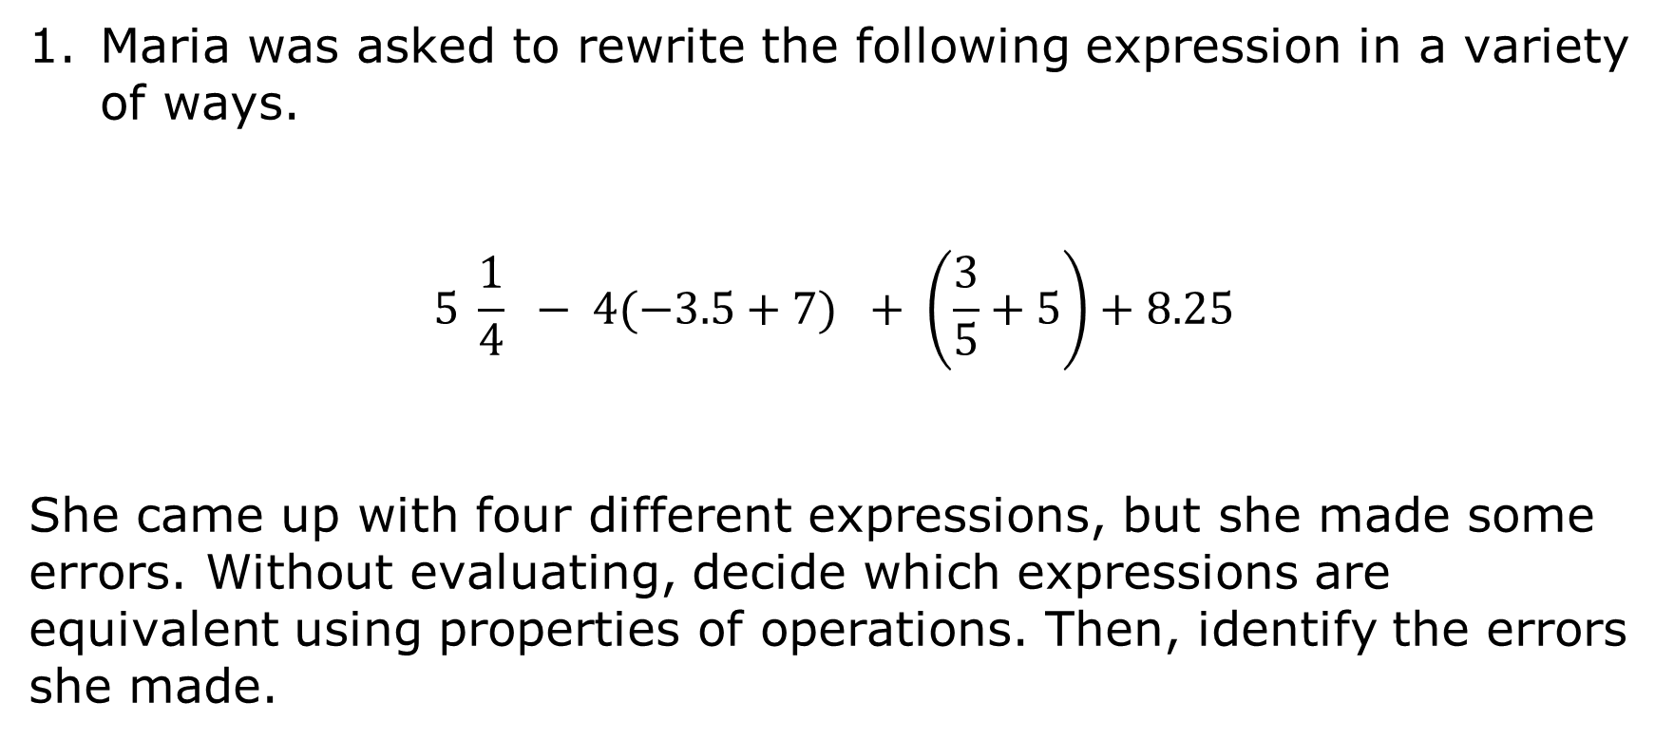
9.6.3 Try It: Rewriting Equivalent Expressions
Maria was asked to rewrite the following expression in a variety of ways.
$$5 \frac{1}{4} − 4(−3.5+7) + \left(\frac{3}{5}+5\right)+8.25$$
She came up with four different expressions, but she made some errors. Without evaluating, decide which expressions are equivalent using properties of operations. Then, identify the errors she made.
volume 2, pg. 68

Slide 17
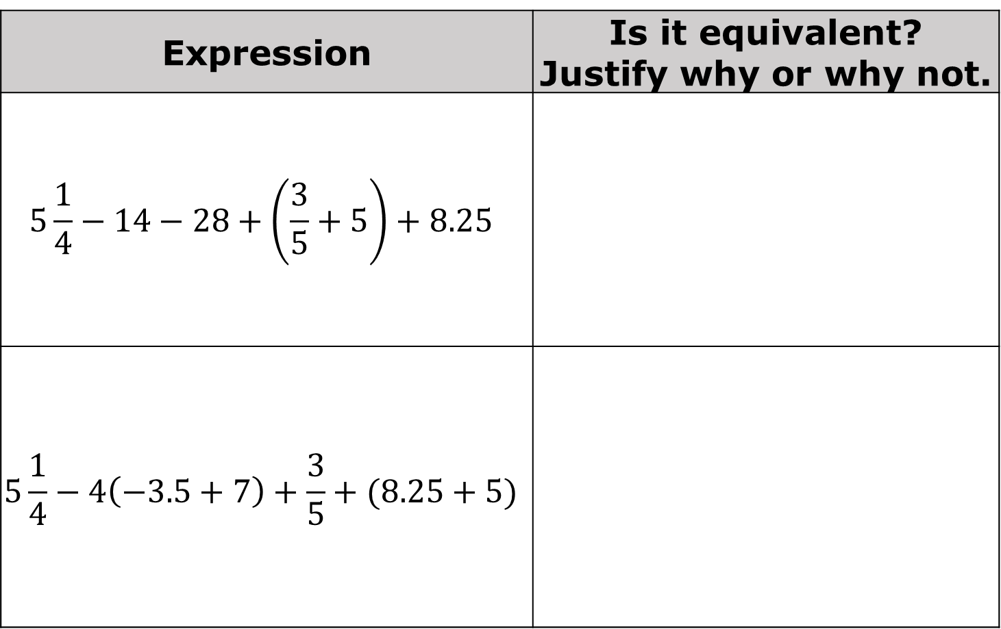
Expression | Is it equivalent? Justify why or why not.
$$5\frac{1}{4}−14−28+\left(\frac{3}{5}+5\right)+8.25$$
$$5\frac{1}{4}−4\left(−3.5+7\right)+\frac{3}{5}+(8.25+5)$$
volume 2, pg. 68

Slide 18
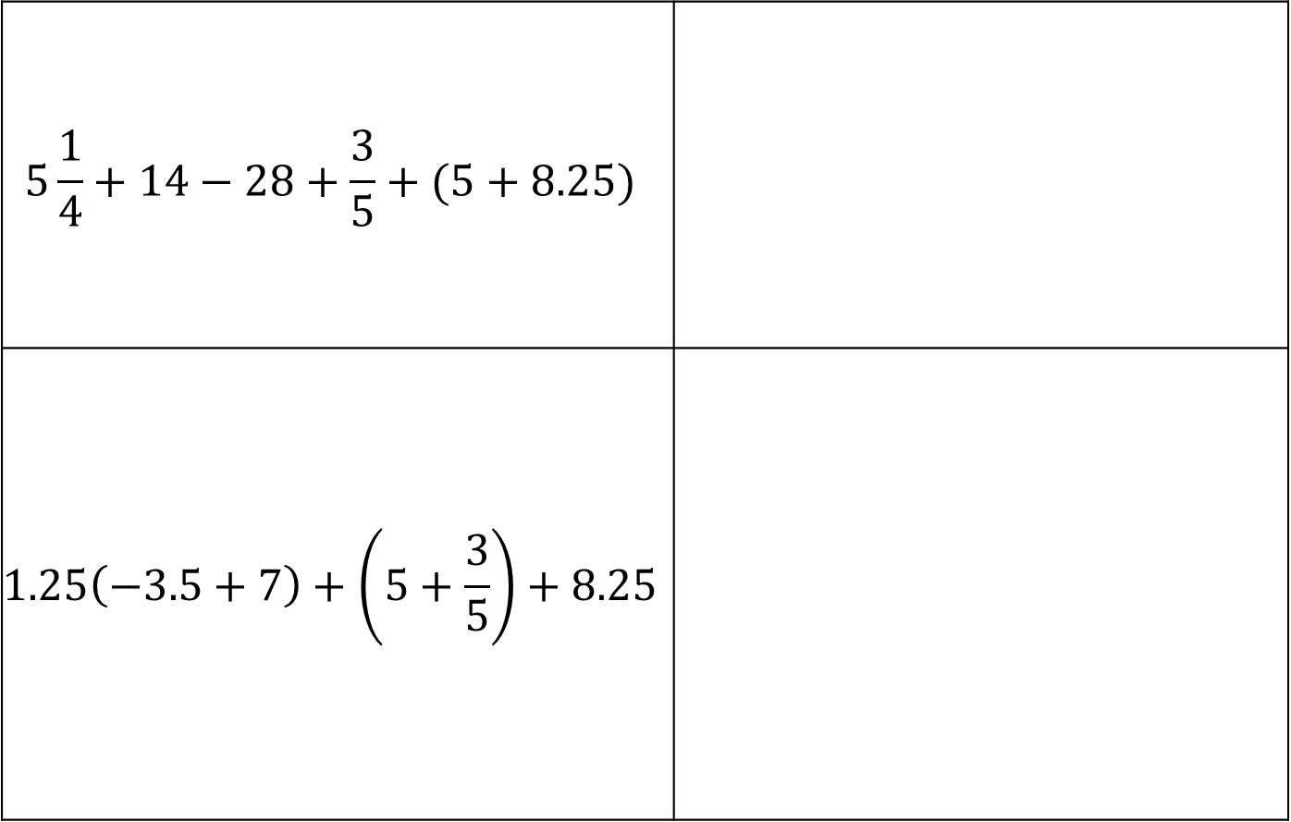
$$5\frac{1}{4}+14−28+\frac{3}{5}+(5+8.25)$$
$$1.25\left(−3.5+7\right)+\left(5+\frac{3}{5}\right)+8.25$$
volume 2, pg. 69

Slide 19

Your Turn
volume 2, pg. 69

Slide 20
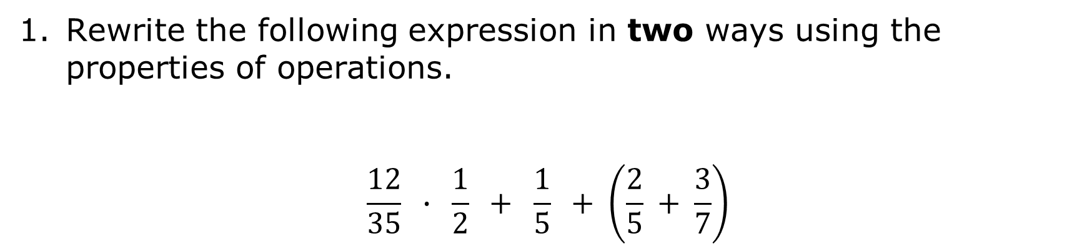
9.6.4 Your Turn!
Rewrite the following expression in two ways using the properties of operations.
$$\frac{12}{35} ∙ \frac{1}{2} + \frac{1}{5} + \left(\frac{2}{5} + \frac{3}{7}\right)$$
volume 2, pg. 69

Slide 21

Wrap-Up
volume 2, pg. 70

Slide 22
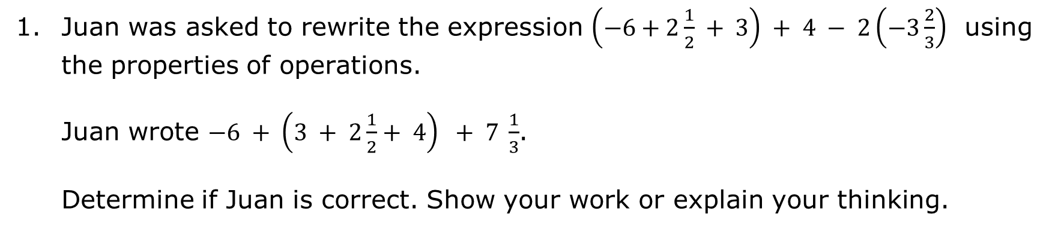
9.6.5 Wrap-Up: Error Analysis
Juan was asked to rewrite the expression $\left(−6+2\frac{1}{2} + 3\right) + 4 − 2\left(−3\frac{2}{3}\right)$ using the properties of operations.
Juan wrote $−6 + \left(3 + 2\frac{1}{2}+ 4\right) + 7 \frac{1}{3}$.
Determine if Juan is correct. Show your work or explain your thinking.
volume 2, pg. 70

